Slide 1
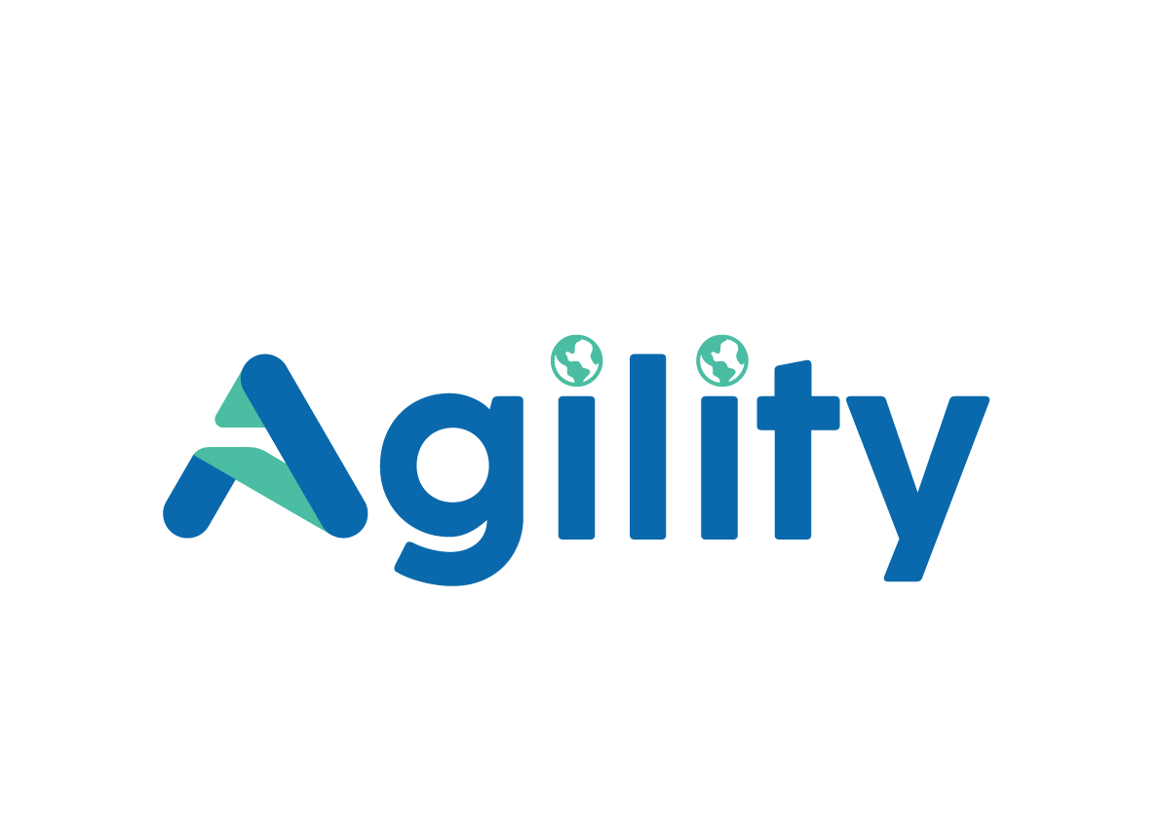

Intelligent Automation for Compliance-Driven Teams
Eliminating manual document processing, data entry, and reconciliation so your team can focus on advisory and client relationships.
https://www.agilitytech.ai/

Slide 2





WHO WE ARE
A data and AI engineering firm that ships production-grade results in weeks.
Agility is a data and AI engineering firm. We build production-grade automation systems on your existing tools. Not prototypes, not pilots, not strategy decks.
Agility engineers data and AI systems for compliance-driven businesses. We own the problem end-to-end: scoping, building, and deploying on your real infrastructure.
01
From 3 Hours to 5 Minutes. On Your Real Data.
02
Trusted Across 30+ Countries. Rated 5 Stars on Clutch.
We pick your highest-pain manual process, PDF extraction, multi-platform data entry, compliance tracking, and automate it end-to-end. You measure the result on live data before we go any further.
No account managers in the middle, no handoffs. Priced 40–60% below Big-4. ROI tracked from day one.
AI
Data
Automation
We build custom LLM pipelines and document intelligence systems that read, extract, and act on your data without human input.
We unify your data across every platform you run, Tally, QuickBooks, Xero, and more, into a single live layer your team can actually use.
We eliminate the manual layer, PDF extraction, data entry, reconciliation, compliance tracking, and replace it with systems that run without your team touching them.
LLM Pipelines
Document Intelligence
GPT-4o
Claude
RAG Systems
Power BI
Tableau
Looker
AWS
Azure
Tally
PDF Extraction
Excel Output
Tally
Reconciliation
Chatbots

Slide 3
INDUSTRY PAIN POINTS
The manual layer holding back your entire operation.
01
02
03
Valuation: 600-plus engagements, all starting with manual PDF extraction
M&A: due diligence document coordination through email chains
Accounting: the same figures entered into eleven different platforms
Hundreds of documents chased across inboxes with no live tracking
No single view of what is outstanding and what has been received
Every valuation begins by pulling data from PDF statements one by one
Analysis cannot start until extraction is complete
Ind AS, IFRS, and US GAAP data re-keyed separately across every tool
No single source of truth, errors compound across platforms
04
05
Compliance: ROC, MCA, and secretarial deadlines tracked in spreadsheets
Reporting: leadership and clients receive static PDFs, not live data
Filing calendars managed manually across the full entity portfolio
A missed deadline means a fine and a difficult client conversation
No real-time visibility across clients, entities, or filing progress
Status lives in inboxes and shared drives, not a single dashboard
agilitytech.ai

Slide 4





OUR COVERAGE
We automate across every service line you run.
Valuation
M&A and Due Diligence
Accounting and Bookkeeping
PDF extraction from financial statements
Automatic model population
Structured report output
Automated document request portal
Live tracking across all target submissions
DD checklist management
Data entry elimination across 11-plus platforms
Multi-standard reconciliation (Ind AS, IFRS, US GAAP)
Automatic exception flagging
Compliance and Secretarial
Reporting and Client MIS
Automated ROC, MCA, and event-based filing calendar
Deadline alerts across your entity portfolio
KYC collection and tracking
Live Power BI, Tableau, and Looker dashboards
Client-facing portals replacing static PDFs
Real-time MIS for retainer clients

Slide 5





WHAT WE BUILD FOR YOU
Six automation solutions built for compliance and advisory teams.
PDF to Excel Automation
Intelligent Data Entry Elimination
Document Collection and Tracking
Multi-format ingestion (invoices, GST, bank statements)
Intelligent header and data row detection
Zero manual handling, structured output ready for import
Auto-populates Tally, QuickBooks, Xero from source docs
No re-keying, no platform discrepancies
Configurable mapping rules per client
Automated client document request emails
Structured reminders per filing cycle
Live dashboard: outstanding items per client
Reconciliation Automation
Internal Query Chatbots
BI Dashboards and Reporting
Cross-matches bank, ledger, GST, and TDS data
Exception flagging with clear audit trail
Eliminates manual cross-checking
Trained on firm filings, templates, and procedures
Instant answers without searching shared drives
Reduces escalations to senior staff
Live Power BI, Tableau, or Looker dashboards
Compliance status, portfolio health, firm-wide view
Replaces static monthly PDFs

Slide 6
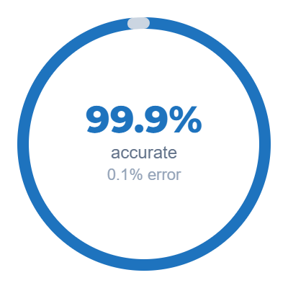
PROVEN RESULTS
What this looks like in practice.
PROCESSING TIME PER BATCH
AFTER AGILITY
MONTHLY STAFF CAPACITY
AFTER AGILITY
DATA ACCURACY
AFTER AGILITY
2 to 3 hours
5 min
150 to 180 hrs
~12 hrs
~95%
99.9%
before
97.5% faster
before
Team freed for advisory
before
Full audit trail
Processing time per batch
Hours per month
2–3 hrs
Before
165 hrs
After
12 hrs
92% reduction in staff time spent on data entry
99.9% accurate
0.1% errors
Data accuracy in production
5 min
Before
After
97.5% reduction in processing time
x

Slide 7
CASE STUDY
Insurance Brokerage Firm, United States
THE PROBLEM
WHAT AGILITY BUILT
HOW IT WORKS
50-plus carriers, each sending statements in a different format
2 to 3 hours per statement, 150 to 180 hours consumed every month 5 percent error rate, constant correction cycles, delayed month-end close
Multi-format ingestion engine handling xlsx, xls, csv, txt, and ods
Intelligent header detection across any carrier file structure
Automated GST and TDS calculations, 27-column standardised output
Any carrier file dropped in, no manual configuration per format
Rules engine maps each transaction to the correct bank ledger
Full audit trail on every transaction. Zero disruption during rollout
97.5%
150+
<0.1%
50+
Processing time
Hours recovered
Error rate
Carrier formats
IMPACT ON BUSINESS
CLIENT BENEFIT
Processing dropped from 2 to 3 hours per batch to under 5 minutes
Same-day processing became the default across all 50-plus carriers
150-plus hours consumed by data entry returned to the team monthly
Error rate fell from approximately 5 percent to under 0.1 percent
Full audit trail on every transaction, producible on demand
Monday morning backlogs eliminated entirely
Finance team redirected to higher-value advisory work
Portfolio grew without adding headcount
Correction cycles and client escalations stopped entirely
Freed budget commissioned the next phase of automation

Slide 8
OUR APPROACH
A structured approach with low disruption and measurable ROI.
1
2
3
4
Discovery
Pilot
Deploy
Expand
We map highest-volume manual workflows across all three practices
Clear findings presented with no jargon
One agreed priority process selected to go first
That process is automated end-to-end on your real data
You measure the result before any broader rollout is agreed
Full production deployment with your team trained on the system
Integrates directly with Tally, Excel, and your existing practice software
Zero disruption to live client work during rollout
Automation extended across additional workflows as ROI is confirmed
Monthly reporting on capacity recovered, errors caught, and value delivered
You decide the pace of rollout at every stage
,
You see a working result on your real data before committing to anything further. Every engagement runs on that principle.

Slide 9







DATA INTELLIGENCE AND REPORTING
Real-time intelligence across all three practices.
Live dashboards in Power BI, Tableau, or Looker
Compliance status, deal pipeline, and client portfolio health in real time
Available to both leadership and clients
DATA PIPELINE
Unified data layer across all eleven platforms
Your existing source platforms
One source of truth connecting SourceIN, Valserve Advisors, and !DENTIZE
Eliminates conflicting reports across tools
Tally
QuickBooks
Xero
Sage
MYOB
+ 6 more
Live MIS reporting for retainer clients
Static monthly PDFs replaced with interactive dashboards
SourceIN clients access directly
AGILITY
Unified Data Layer
Cloud migration on Azure or AWS
Structured · Validated · Always current
Multi-jurisdiction, multi-standard environments supported
Move beyond legacy tools at your own pace
Power BI
Tableau
Looker

Slide 10
COLLABORATION OPPORTUNITY
Become the AI and data partner your clients do not have yet.
1
2
3
White-Label
Co-Branded Delivery
Referral
Agility builds and operates the solution behind the scenes
Your clients see only the Valserve name
Full control over pricing and positioning
Joint Agility and Valserve engagement
Present together, deliver together, share the commercial outcome
Strongest capability signal to the client
You identify the need and make the introduction
Agility handles scoping, delivery, and client management
You receive a revenue share on every engagement
INDUSTRIES WE CAN TARGET
Pharmaceutical
Information Technology
Chemical
Capital Goods
Financial Services
Manufacturing
Real Estate
Healthcare
Consumer Goods
Logistics
Energy
Professional Services

Slide 11
NEXT STEPS
Let us explore this together.
We would welcome a POC/MVP to identify one high-impact workflow across your three practices and show you what automation looks like on your real data
THANK YOU !
Email
Website
info@agilitytech.ai
agilitytech.ai

